Slide 1
A Yang Data Model for ACTN VN Operation draft-ietf-teas-actn-vn-yang-01
Young Lee, Dhruv Dhody, Daniele Ceccarelli
Igor Bryskin, Bin Yeong Yoon, Qin Wu, Peter Park

Slide 2
Status
Adopted as WG draft after IETF 101.
Integrated/consolidated with draft-wu-opsawg-network-overlay-resource-model-00 with this draft (new co-authors)!
Clarified the relationship of the draft with other service models and TE-topology:
The VN model defined in this document can also work together with other customer service models such as L3SM [RFC8299], L2SM and L1CSM to provide a complete life-cycle service management and operations.
The actual VN instantiation and computation is performed with “Connectivity Matrices” sub-module of TE-Topology Model which provides TE network topology abstraction and management operation.
Once TE-topology Model is used in triggering VN instantiation over the networks, TE-tunnel Model will inevitably interact with TE-Topology model for setting up actual tunnels and LSPs under the tunnels.

Slide 3
Next Step
Work on Security and IANA Sections in the next revision.
Refine the draft to make it ready for WG LC.

Slide 4
BACKUP!

Slide 5
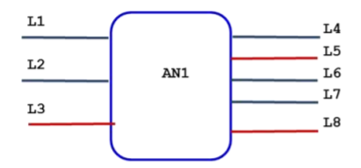

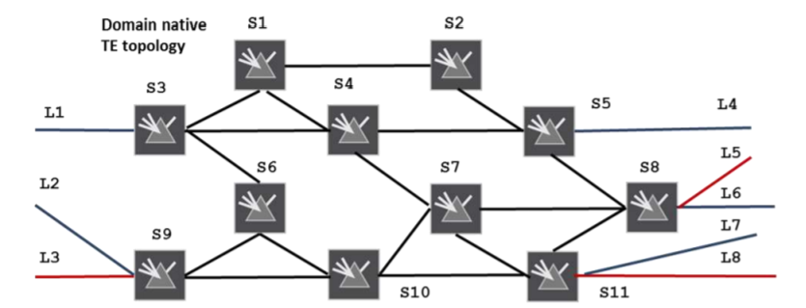
Overview
Abstract Topology with a
Single Node
ACTN VN Yang Model
AP/VNAP
VN
VN-Member
Connectivity
Matrix
For both VN Type 1 or Type 2 VN Yang model rely on a single node in the abstract TE Topology
The abstract node has
connectivity-matrices
connectivity-matrix [id]
The attributes directly under container connectivity-matrices are the default attributes for all connectivity-matrix entries when the per entry corresponding attribute is not specified. When a per entry attribute is specified, it overrides the corresponding attribute directly under the container connectivity-matrices.
Underlay

Slide 6
Node
connectivity-matrices
underlay
primary-path
path-constraints
Optimizations
computed-path-properties
connectivity-matrix [id]
From
underlay
Primary-path
path-constraints
Optimizations
To
tunnel-termination-points
tunnel
Overview
ACTN VN
AP
VNAP
VN
VN-Member
From
To
/nw:networks/nw:network/nw:node/te-node-id
global
Per entry

Slide 7
How: Reference to TE Topology Yang Model
Access | AP/ VNAP -> LTP Ltp of type te-types:te-tp-id
Customer’s Virtual Network | VN -> Abstract Node vn-topology-id of type te-types:te-topology-id abstract-node -> /nw:networks/network/node/tet:te-node-id (reference)
Customer Site to Site connection | VN-Member -> Entry in the connectivity matrix of the abstract node connectivity-matrix-id -> /nw:networks/network/node/tet:te/te- node-attributes/connectivity-matrices/connectivity-matrix/id (reference)
All parameters which are can be set as global attributes to VN are set in the connectivity-matrices (such as bandwidth) and an attribute for a particular VN-member is set in the connectivity-matrix [id] (such as explicit path)!
Duplicate parameters in ACTN VN Yang model are removed!

Slide 8
VN Type 1
VN is seen as edge to edge links (VN-members) setup as tunnels across underlying networks!
Abstract Topology with a
Single Node
VN 1
VN-Member 1 L1-L4
VN-Member 2 L1-L7
VN-Member 3 L2-L4
VN-Member 4 L3-L8
This VN has following properties
Bandwidth 500
Optimize by delay
connectivity-matrices
Attributes
These properties
are set in TE Topo
14: L1-L4 | 17: L1-L7
24: L2-L4 | 38: L3-L8
Connectivity
Matrix

Slide 9
VN Type 2
Abstract Topology with a
Single Node
VN is seems as a topology of virtual nodes and links
To ease mapping between VN Yang Model and TE models, an abstract single node topology is created with VN topology as the underlay!
The same mapping as VN Type 1 is reused.
VN 2
VN-Member 1: L1-L8 via S3, S67110, S11
Set via the underlay path in connectivity-matrix[id]
Underlay
VN Topology
S3
S124
S5
S8
S9
S67110
S11
Underlay

